Slide 2


Poke the box R console!
There was a “>” with a flashing cursor after it
I typed this and hit Enter
> 1+1
[1] 2
R printed this!
You can ignore the [1] thing for now

Slide 3
Poke the box R console!
Insights…
R does math!
For now, you can think of it as a fancy calculator
1+1
[1] 2

Slide 4
Poke the box R console!
Insights…
R does math!
R ignores whitespace
You can space things out for readability
1+1
[1] 2
1 + 1
[1] 2

Slide 5
Poke the box R console!
Insights…
R does math!
R ignores whitespace
R uses functions
Things that go inside the parentheses (function inputs) are referred to as “arguments” of the function
1+1
[1] 2
1 + 1
[1] 2
sqrt(49)
[1] 7

Slide 6
Poke the box R console!
Insights…
R does math!
R ignores whitespace
R uses functions
R is case-sensitive
Errors happen!!!
YOUR COMPUTER WILL NOT EXPLODE
Errors are not problems, just puzzles (Error messages might be clues)
1+1
[1] 2
1 + 1
[1] 2
sqrt(49)
[1] 7
Sqrt(49)
Error in Sqrt(49) : could not find function "Sqrt"

Slide 7
Poke the box R console!
Insights…
You can store variables using “<-”
Sometimes people say “gets” as verbal shorthand
Terminology: this is referred to as an assignment statement
You can make names descriptive
meaningOfLife <- 42
meaningOfLife + 1
[1] 43

Slide 8
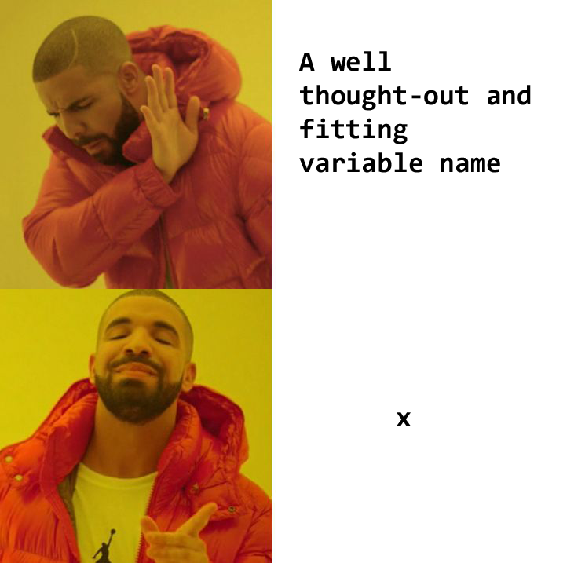
“There are only two hard thing in computer science: Cache invalidation and naming things.” – Phil Karlton
Naming rules in R:
Can use letters, numbers, “_”, and “.”
Must begin with a letter (catch_2023, not 2023_catch)
Try to make names memorable and recognizable to others
Avoid using function names (e.g. mean, var, etc.)
But R is usually smart enough to handle this
Case conventions you may see:
this_is_snake_case
thisIsCamelCase
kebab-case-is-not-allowed-in-R
dot.case.is.not.recommended

Slide 9
That’s great, but what if I have more than one number?
First, a few new tools:
The c( ) function can be used to construct a vector, that is, an ordered set
Don’t worry, functions that read data directly from .csv, .txt, xlsx, etc. will be introduced soon!
c(1, 1, 2, 3, 5, 8)
[1] 1 1 2 3 5 8

Slide 10
That’s great, but what if I have more than one number?
First, a few new tools:
The c( ) function can be used to construct a vector, that is, an ordered set
The : operator can be used to construct a sequence of integers
c(1, 1, 2, 3, 5, 8)
[1] 1 1 2 3 5 8
2014:2023
[1] 2014 2015 2016 2017
[5] 2018 2019 2020 2021
[9] 2022 2023
Insight…
That weird [1] thing we keep seeing? It’s just R labeling the index of the first element of each row of output!

Slide 11
That’s great, but what if I have more than one number?
First, a few new tools:
The c( ) function can be used to construct a vector, that is, an ordered set
The : operator can be used to construct a sequence of integers
The seq( ) function can be used to construct a custom sequence
c(1, 1, 2, 3, 5, 8)
[1] 1 1 2 3 5 8
2014:2023
[1] 2014 2015 2016 2017
[5] 2018 2019 2020 2021
[9] 2022 2023
seq(from=0, to=1, by=0.2)
[1] 0.0 0.2 0.4 0.6 0.8 1.0
seq(0, 1, length.out=6)
[1] 0.0 0.2 0.4 0.6 0.8 1.0
Insights…
There are often multiple ways to do the same thing in R
Functions can have multiple possible arguments

Slide 12
Introducing vector operations…
The most basic structure in R is a vector
Many (most) operations in R can be evaluated vector-wise
What does this mean?
a <- c(10, 20, 30)
b <- c(1, 2, 3)
a * b
[1] 10 40 90

Slide 13
Introducing vector operations…
The most basic structure in R is a vector
Many (most) operations in R can be evaluated vector-wise
What does this mean?
What happens when you mix vectors and single numbers?
a <- c(10, 20, 30)
b <- c(1, 2, 3)
a * b
[1] 10 40 90
a + 1
[1] 11 21 31

Slide 14
Some operators & functions…
The usual cast of characters: +, -, *, /, ^
1+2*3-4^5/(6-7)
[1] 1031
1+(2*3)-((4^5)/(6-7))
[1] 1031
Insights…
You can use parentheses in mathematical operations, too
R is pretty smart about order of operations (but I’m still nervous to trust it!)

Slide 15
Some operators & functions…
The usual cast of characters: +, -, *, /, ^
sqrt(), log(), exp(), abs()
1+2*3-4^5/(6-7)
[1] 1031
1+(2*3)-((4^5)/(6-7))
[1] 1031
sqrt(c(0, 1, 4, 9, 16, 25, 36))
[1] 0 1 2 3 4 5 6
Insight…
Mathematical functions can generally be evaluated vector-wise

Slide 16
Some operators & functions…
The usual cast of characters: +, -, *, /, ^
sqrt(), log(), exp(), abs()
sum(), prod()
mean(), median(), quantile(), sd(), var()
1+2*3-4^5/(6-7)
[1] 1031
1+(2*3)-((4^5)/(6-7))
[1] 1031
sqrt(c(0, 1, 4, 9, 16, 25, 36))
[1] 0 1 2 3 4 5 6
median(c(0, 1, 4, 9, 16, 25, 36))
[1] 9
Insight…
Some functions need a vector input!

Slide 17
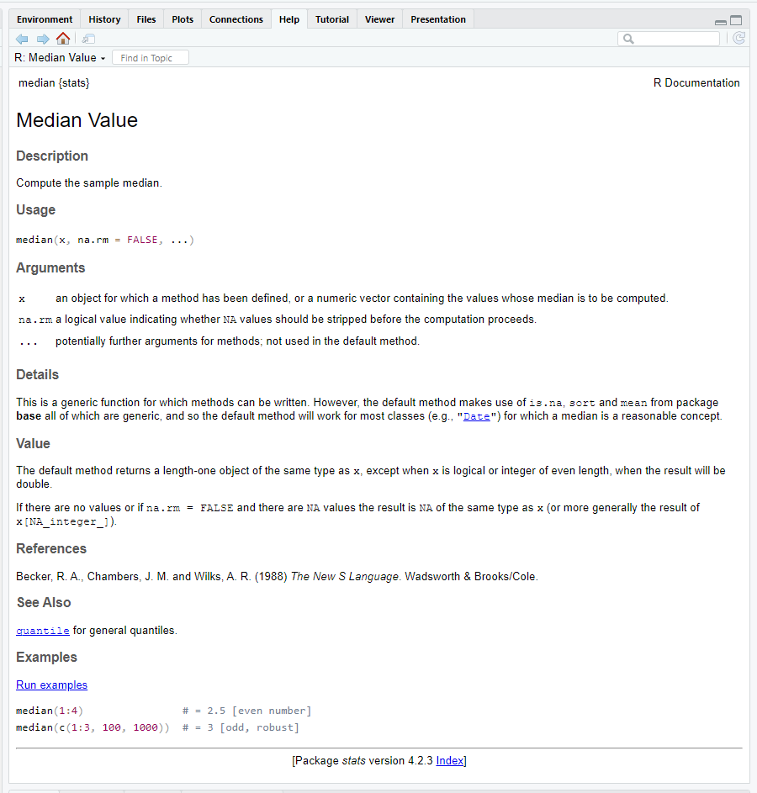
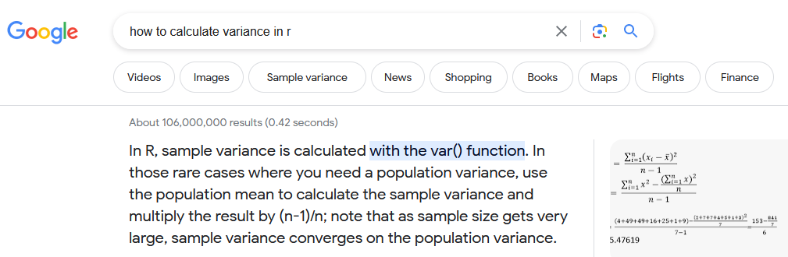
Help!
?median
help("median")

Slide 18
QUIZ: How would the following evaluate?
xx <- 10
yy <- 1:3
zz <- c(2, 4, 6)
xx + yy + zz
[1] 13 16 19
[1] 48
Something else
An error or warning

Slide 19
QUIZ: How would the following evaluate?
xx <- 10
yy <- 1:3
zz <- c(2, 4, 6)
xx + yy + zz
[1] 13 16 19
[1] 48
Something else
An error or warning
Length 1
Length 3
Length 3
Result will be length 3

Slide 20
QUIZ: What do you think will happen?
aa <- c(1, 3, 5)
bb <- c(1, 2)
aa * bb
[1] 1 3 5
[1] 1 6
Something else
An error or warning

Slide 21
QUIZ: What do you think will happen?
aa <- c(1, 3, 5)
bb <- c(1, 2)
aa * bb
[1] 1 6 5
Warning message:
In aa * bb :
longer object length is not a multiple of shorter object length
[1] 1 3 5
[1] 1 6
Something else
An error or warning
Insight…
R will probably warn you if it thinks something is weird

Slide 22
Let’s talk about NA
a <- c(1, 2, 3, 4, NA)
b <- c(2, 4, 6, 8, 10)
a + b
[1] 3 6 9 12 NA
mean(a)
[1] NA
mean(a, na.rm = TRUE)
[1] 2.5
An NA is a known “unknown”
Blank cells in spreadsheets are typically imported as NA
R will generally return NA or Error when NA is used in calculations
Which is good!
There are ways around this, if appropriate

Slide 23
Classes of vectors: R can store different kinds of information
Less complex
 | Possible values | can be used in mathematical expressions
logical | FALSE or TRUE (or NA) | yes
numeric | all numbers (or NA / NaN / Inf) | yes
character | most combinations of letters, numbers, and special characters (or <NA>) | no
Can be changed into a different class without losing information
More complex

Slide 24
Classes of vectors
myName <- "Inigo Montoya"
1 + "Bob"
Error in 1 + "Bob": non-numeric argument to binary operator
"2" + 4
Error in "2" + 4: non-numeric argument to binary operator
heres_a_logical_vector <- c(TRUE,
FALSE, TRUE, FALSE, TRUE)
heres_a_logical_vector
[1] TRUE FALSE TRUE FALSE TRUE
Title looks scary, but
It’s actually pretty obvious what can & can’t happen
Insights…
Quotes in an assignment statement tell R to interpret something as character
Note: “ “ and ‘ ‘ can both be used as long as you’re consistent on both sides
R knows what TRUE and FALSE mean without quotes

Slide 25
So what did I mean about changing classes?
Less complex
logical
numeric
logical
numeric
character
c(TRUE, FALSE, TRUE, FALSE, 5)
[1] 1 0 1 0 5
More complex
The result becomes numeric

Slide 26
So what did I mean about changing classes?
Less complex
logical
numeric
logical
numeric
character
c(TRUE, FALSE, TRUE, FALSE, 5)
[1] 1 0 1 0 5
More complex
The result becomes numeric
Insights
All elements of a vector will be the same class!
Hey look, you can use whole vectors as arguments in c( )
numeric
character
c(seq(2, 8, by=2), "Who do we appreciate")
[1] "2" "4" "6" "8" "Who do we appreciate"
The result becomes character

Slide 27
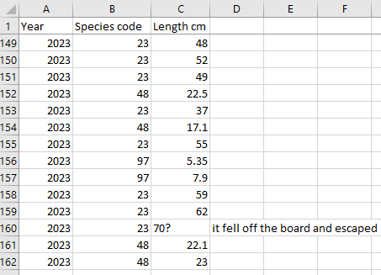
Too deep too fast, Matt. Why do we care???
Take-home message:
Different classes (types of data) exist!
R can do different things with different classes
R may do things you didn’t intend
numeric
character

Slide 28
Btw: yes, we can change classes manually*
*Please don’t worry about this, it’s included for completeness
smellsLikeSchoolSpirit <- c(seq(2, 8, by=2), "Who do we appreciate")
as.numeric(smellsLikeSchoolSpirit)
[1] 2 4 6 8 NA
Warning message:
NAs introduced by coercion

Slide 29
One last vector class: factor
Like character, but with a guest list!
tech_char <- c("Chuck","Albert","Betty","Albert","Betty")
tech_factor <- as.factor(tech_char)
tech_char
[1] Chuck Albert Betty Albert Betty
tech_factor
[1] Chuck Albert Betty Albert Betty
Levels: Albert Betty Chuck
as.numeric(tech_factor)
[1] 3 1 2 1 2
Insights
R will probably try to alphabetize your factor levels (May will come after June)
Come to think of it, I’m writing this in June 2023 and it feels like May hasn’t happened yet

Slide 30
An important special character: #
Everything to the right of # is not evaluated
2 + 2 # two by two, hands of blue
[1] 4

Slide 31

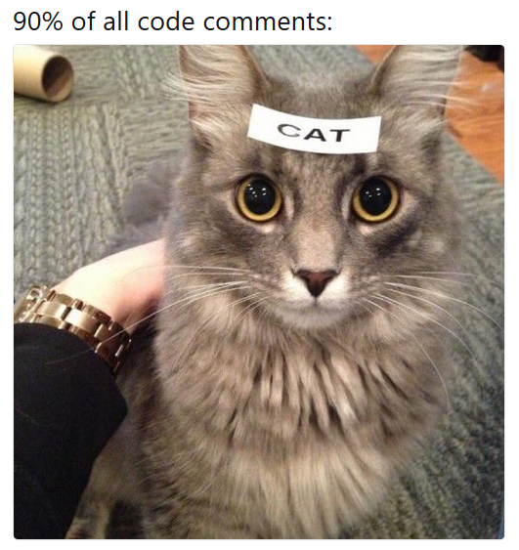
An important special character: #
Everything to the right of # is not evaluated
This means you can (and should) leave notes
This is called commenting your code
One day, someone will need to understand your code
IT WILL BE YOU ☺
N_hat <- (n1 + 1)*(n2 + 1)/(m2 + 1) – 1 # Chapman Estimator of abundance
…of course, there’s an art to commenting code…

Slide 32
Concepts to take away from this session:
R does math!
1+2*3-4^5/(6-7)
[1] 1031
1+(2*3)-((4^5)/(6-7))
[1] 1031

Slide 33
Concepts to take away from this session:
R does math!
R uses functions with multiple possible arguments (inputs)
sqrt(49)
[1] 7
median(c(1, 1, 2, 3, 5, NA), na.rm=TRUE)
[1] 2

Slide 34
Concepts to take away from this session:
R does math!
R uses functions with multiple possible arguments (inputs)
You can store results in variables that you create
Note: these go away when you close R, but that’s a good thing
N_hat <- (n1 + 1)*(n2 + 1)/(m2 + 1) – 1
myNameIs <- c("Inigo Montoya", "Slim Shady", "Ozymandias")

Slide 35
Concepts to take away from this session:
R does math!
R uses functions with multiple possible arguments (inputs)
You can store results in variables that you create
Note: these go away when you close R, but that’s a good thing
R uses vectors (ordered sets) and does most operations vector-wise
vector
vector
single number (actually a vector of length 1)
c(1, 2, 3) * c(10, 20, 30) + 5
[1] 15 45 95
vector

Slide 36
Concepts to take away from this session:
R does math!
R uses functions with multiple possible arguments (inputs)
You can store results in variables that you create
Note: these go away when you close R, but that’s a good thing
R uses vectors (ordered sets) and does most operations vector-wise
There are different classes of vectors (logical, numeric, character, factor) for storing different types of information
Don’t worry about memorizing this, it’s just for reference!
Class | Possible values | Can it math?
logical | FALSE or TRUE (or NA) | yes
numeric | all numbers (or NA / NaN / Inf) | yes
factor | most combinations of letters, numbers, and special characters from a defined set (or <NA>) | no
character | most combinations of letters, numbers, and special characters (or <NA>) | no
Can be changed into a different class without losing information
FALSE = 0, TRUE = 1

Slide 37
Also…
Help exists!
NA exists too, it’s just a known unknown
# lets you add helpful notes to others or yourself
Errors and Warnings happen all the time, and may offer clues
“Error” means an expression didn’t evaluate
“Warning” means it did

